Slide 1
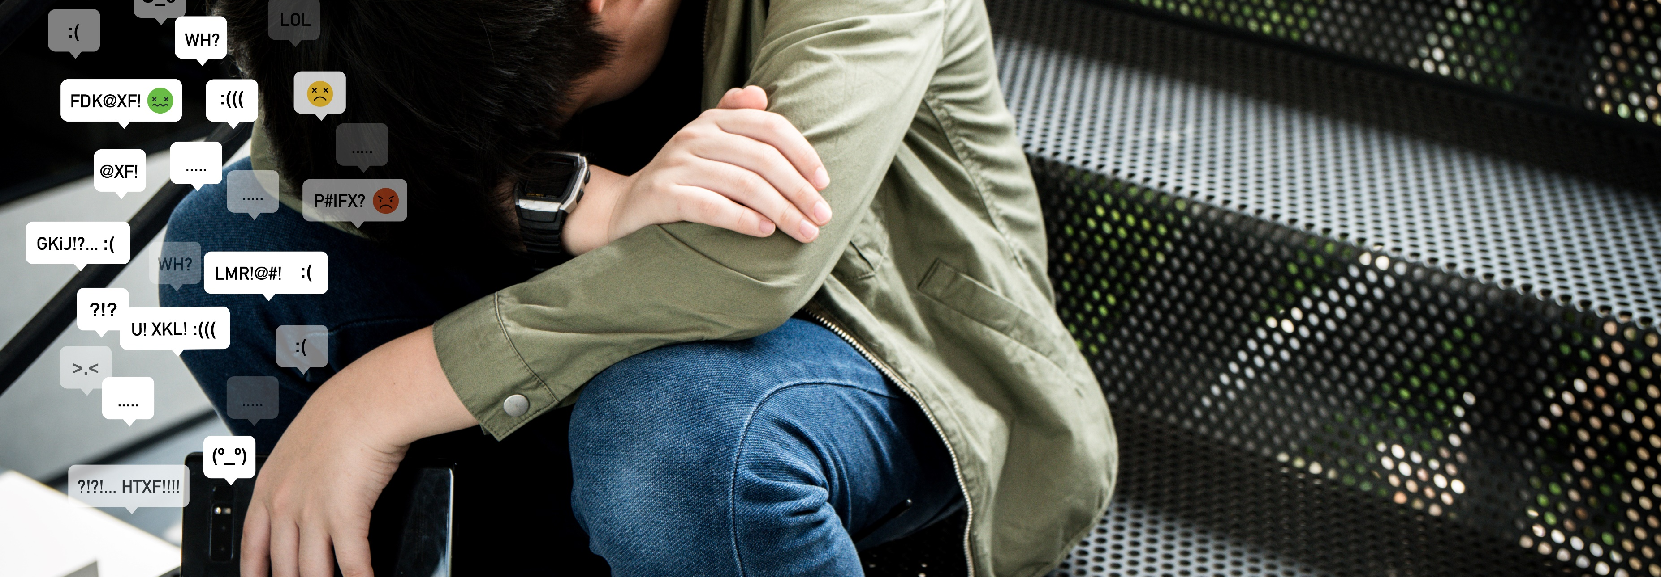
Understanding different forms of violence in school – and effective whole-school responses
Presentation by Joanna Herat, Chief (ai.) Section of Health and Education, Education Sector, UNESCO, Paris
myboys.me/Shutterstock.com
Notes:
Globally, 246 million children and adolescents experience some form of violence in and around school every year, with girls being particularly vulnerable.
Almost one in three students (32%) has been bullied by their peers at school at least once in the last month, and cyberbullying affects as many as 1 in 10 children.
These numbers show us that school violence remains a pervasive problem in all countries.
Globally, the North African region has the second highest prevalence of bullying, at 42.7% (range 30.6%-70%),
Very high levels among boys among boys, at 46%, and among girls, at 39%.
Violence in school is a reflection of violence and power dynamics in wider society… it is also a place where change can happen.

Slide 2

Clare is 12 years old. Over the holidays, her body changed. In the first week back at school, two boys in her class repeatedly point at her chest making signs, laughing, and trying to bump up against her and pull her bra. She started to wish she had never come back to school.
International Symposium – Rabat 2023
Notes:
Beyond the definition, I'd like to give you some concrete examples of what we mean when we talk about school violence. After all, it's a human experience. [read slide] Here, a pubescent adolescent is mocked for her changing body by her peer.

Slide 3
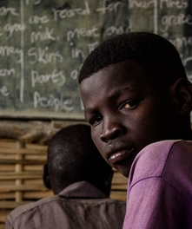
Q&A
Session
Abel is 15 and he has been summoned to the headmasters’ office for making noise during class. As this was not the first time, the headteacher decides to make an example of him and takes him to the classroom, beats him hard with a cane in front of the class, telling him to take it like a man.
International Symposium – Rabat 2023
Notes:
Boys are also victims fo violence – and this can be perpetrated by adults as wel as peers. In fact, physical force is very often the ‘standard’ way for adults and children alike to show power and dominance in the school setting.
Abel is 15 and he has been summoned to the headmasters’ office for making noise during class. As this was not the first time, the headteacher decides to make an example of him and takes him to the classroom, beats him hard with a cane in front of the class, telling him to take it like a man.
The physical abuse here is compounded by the psychological abuse – punishing someone in front of others, and also using belittling language which only service to entrench harmful gender norms.

Slide 4
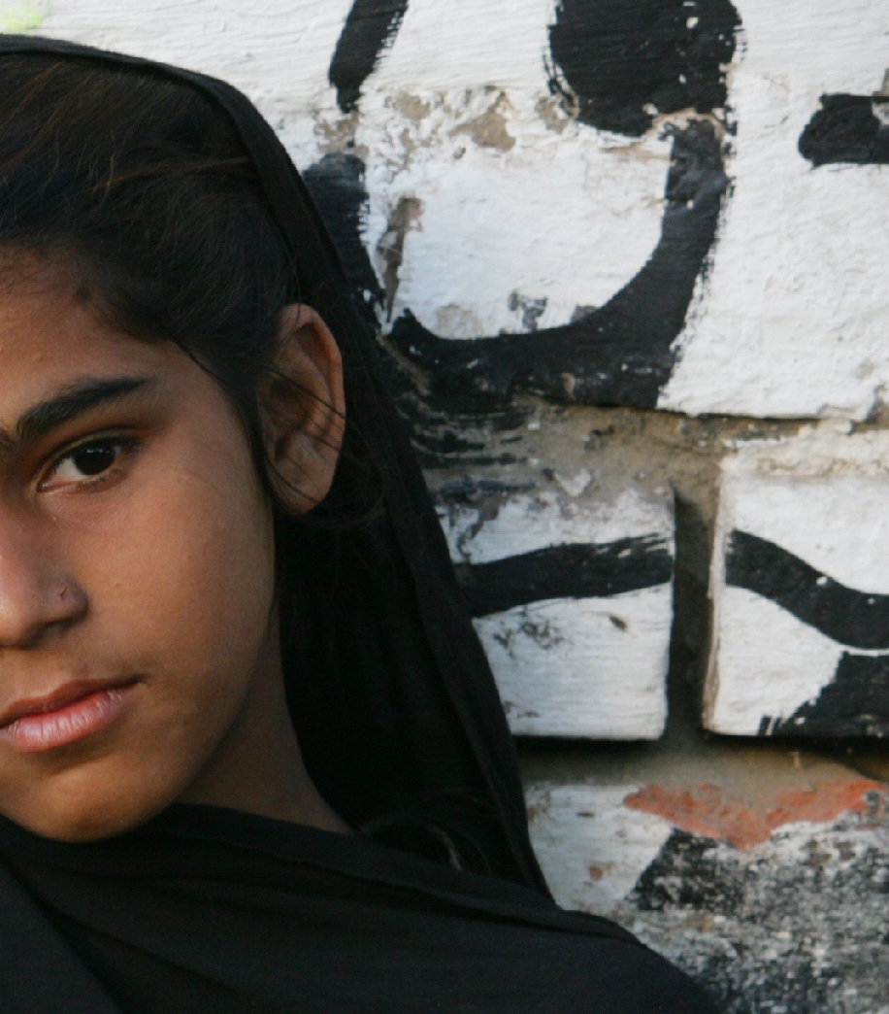
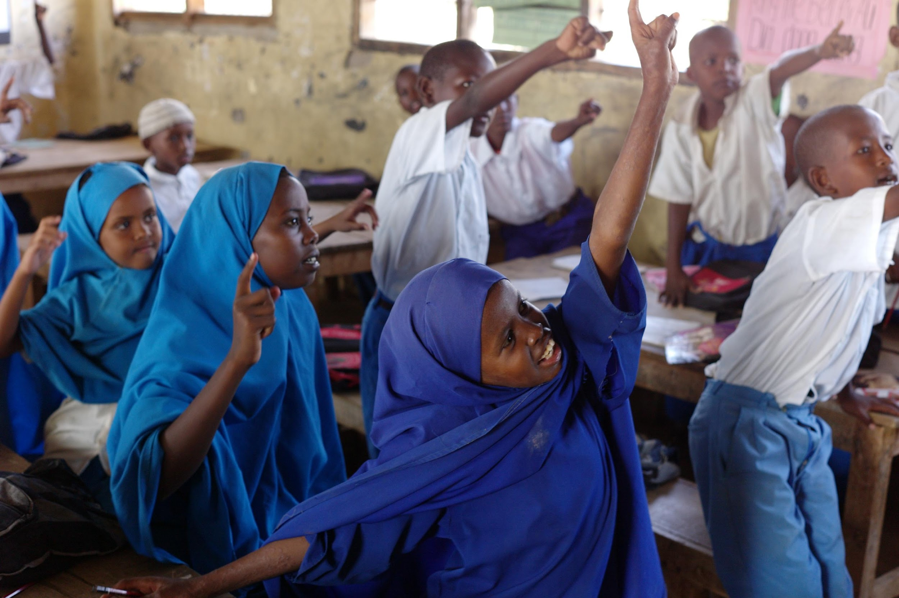
Rita urgently needs to relieve herself. The toilets in her school are damaged and unusable so the female students usually go in the nearby bushes. A group of boys see Rita going to the bushes and follow her to watch her as she lifts her skirt, without her knowing. Lucas, a friend of the boys, sees what they are doing, but decides not to join them. He returns to class unsure what to say or do.
Q&A
Session
International Symposium – Rabat 2023
Notes:
Sexual violence is a major concern in all parts of the world. Sometimes it is physical or forced, but not always. [read]
A group of boys take advantage of the lack of toilets to abuse Rita’s privacy. But not all of them are comfortable about doing this.

Slide 5
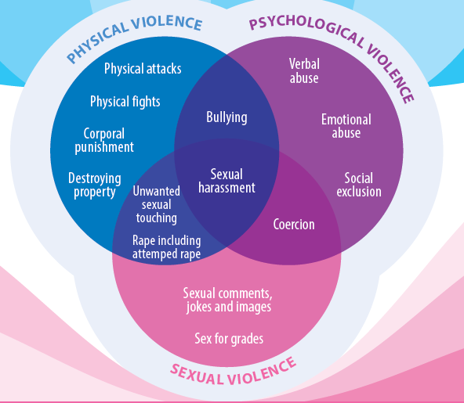
Notes:
As we have seen – there are many different types of violence… physical, psychological and sexual. And they overlap with one another.
Different forms of violence: It includes psychological and physical violence, bullying, cyberbullying, gender-based violence, and sexual harassment.

Slide 6
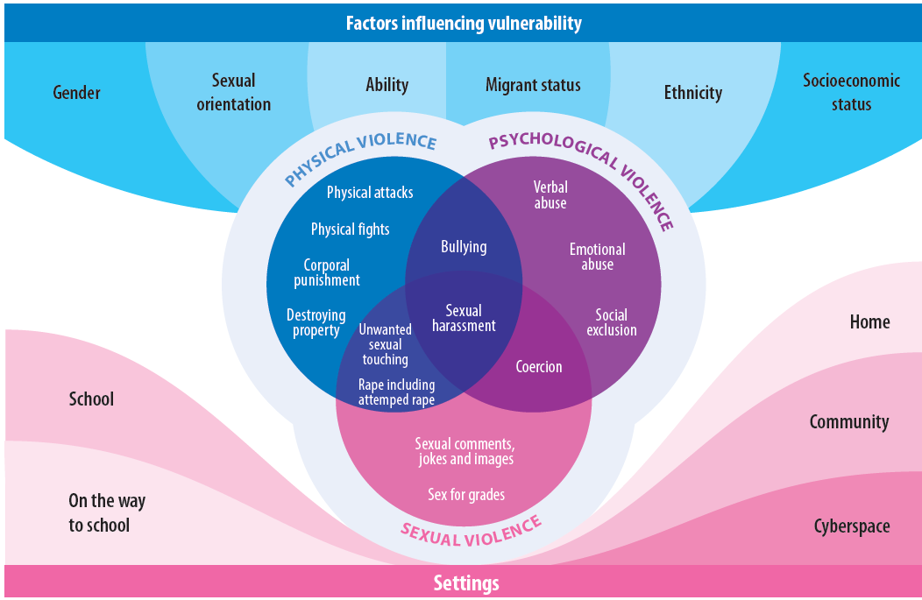
Notes:
As we have also seen, there are different driving forces behind violence especially in the school context.. If we want to have any success in preventing and responding to violence, we have to take all these factors into consideration – these might include ethnicity, or socio-economic status
Gender – as we hae just seen from the examples – is a particularly important factor in violence. Gender inequalities and norms both contribute to and reinforce violence at a broader societal level. This has led to a greater attention to the genederd dimensions of school violence over the past decade. These acts are rooted in gender norms and stereotypes, perpetuated by unequal power dynamics.

Slide 7
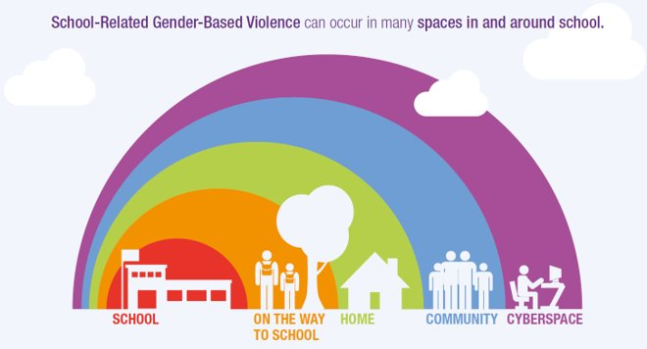
It happens in and around school
School violence goes beyond the school gates…
International Symposium – Rabat 2023
Notes:
Happens beyond the school gates – schools are often described as miniature reflectsions

Slide 8
Impacts of Violence – education suffers as well as child well-being
Violation of the right to education and the right to protection from violence
Violence higher levels of school drop out, illness and grades
Violence affect psychical, psychological and social well-being – now and into the future, including future generations
But schools & educators may not be ready to act:
25% of teachers surveyed did not recognize various forms of violence, physical, sexual & online acts
Only 30% of teachers report having received sufficient training on how to prevent and respond to school violence during pre-service education.
Notes:
Many impacts of violence in schools

Slide 9
Effective responses by the Education Sector?

Slide 10
Whole-school response
Safe psychological and physical school and classroom environment
Learner empowerment
and participation
Strong political leadership
and robust legal and policy framework
Reporting mechanisms for learners affected by violence, together with support and referral services
Training and support
for teachers and other
school staff
Collaboration and partnerships between the education sector and a wide range of partners
Curriculum, learning & teaching to understand violence & vulnerability
Involvement of all stakeholders
in the school community, including parents
Evidence: monitoring
of school bullying and evaluation of responses
International Symposium – Rabat 2023
Notes:
Many different terminologies have been used in different education contexts to describe comprehensive and effective community-based responses to bullying.
The most popular terminology is possibly “whole-school approach”, at least in English-speaking countries.
There are also other terminologies used in English, and probably more in other languages that we are not aware of.
Let me highlight some key features of the whole-school approach.
It is not a shopping list or a menu from which you can pick and choose some components and leave others off. All of the 9 components, as displayed in this slide, are essential and must be combined for the response to be effective.
It is necessary to plan and to implement well-coordinated actions that are systematic and sustainable. Once-off measures such as annual prevention campaigns are not effective.
Emphasis is therefore on significance of the whole system of education. Positive and sustainable change will only take place if the education system as a whole is better equipped to reduce school violence, in all its forms.
To reduce the prevalence of all forms of school violence at the national or sub-national level, programmes selected must be effectively implemented in all schools and communities. Otherwise, the impact of school violence prevention will always be limited to a relatively small number of schools and children.
It is not up to schools to do everything. Education authorities need to provide guidance, support and resources.
Equally important is the understanding that no intervention is successful without the full participation of children and young people, and of all of them. This includes learners targeted by violence, but it has also been shown that all effective anti-school violence programmes are based on the empowerment and participation of those who witness violence.

Slide 11
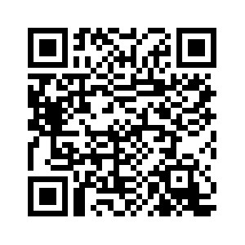
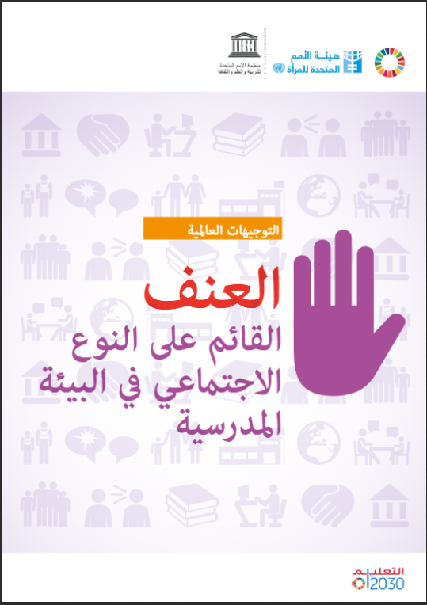
Evidence-based
Guidance
Examples

Slide 12
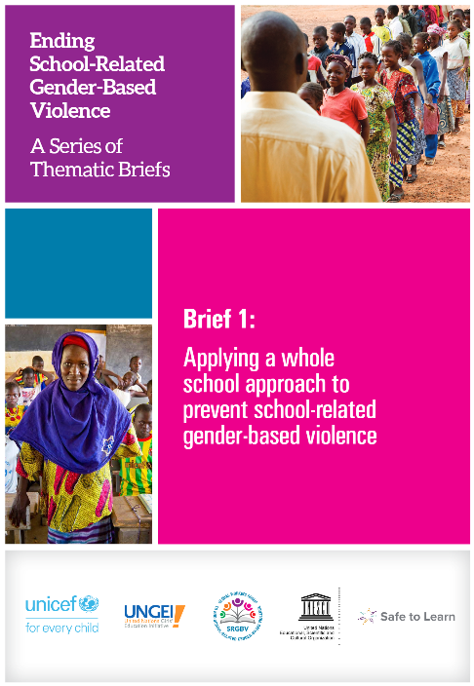
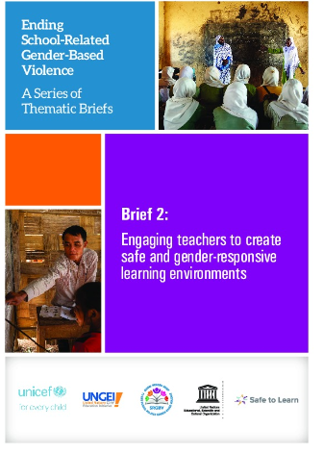
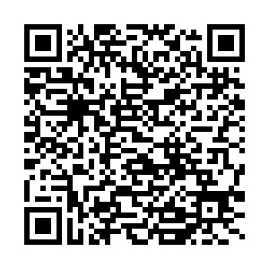
Examples of good practice
Briefs highlighting many examples for whole school approach

Slide 13

The essential role of teachers in ending all forms of school violence
4 in 5 teachers consider it their responsibility to address school violence, yet many lack a comprehensive understanding and struggle to intervene effectively.
50% of teachers report that their school provides adequate opportunities for in-service training and professional development in violence prevention and management.
International Symposium – Rabat 2023
Notes:
Teachers play a crucial role in creating safe, non-violent learning spaces. They are immediate witnesses to school violence, often the first to intervene in violent situations.
Understanding teachers' perceptions, practices, needs, and expectations is vital for strengthening their role in violence prevention. That is why in 2022, we published the technical brief that you see here on screen: this brief is based on 2 UNESCO-commissioned studies. The first study explores teachers' views on violence in schools, supported by the Safe to Learn Partnership. The second study focuses on UNESCO's 'Connect with Respect' program, addressing school-related gender-based violence in five countries.
Four in five teachers consider it their responsibility to address school violence, yet many lack a comprehensive understanding and struggle to intervene effectively.
25% of teachers surveyed did not recognize various forms of violence, including online acts, highlighting the need for awareness and education.
Teachers alone cannot bear the entire responsibility; collective efforts are essential.

Slide 14
Example – SUPPORTING TEACHERS TO BE AGENTS OF CHANGE
RECOMMENDATIONS
- Reflective processes that allow teachers to consider their own views and experiences of violence
- Building empathy and teachers’ confidence
- Enabling peer learning and building networks of peer educators
BUT!
Changing the way teachers see themselves and their role as educators does not happen quickly — it takes time and specialized support.
DEVELOPING CODES OF CONDUCT FOR TEACHERS – ETHIOPIA
Ministry of Education in consultation with Ethiopian Teachers’ Association, civil society and other sectors (support from UNICEF)
- Approaches to discipline, includes sexual harassment and all forms of violence
- Promote positive and preventive actions
- Guidance for responding to violence
- Gender focal point in each school
- Committee of student + teacher + parent + administration in each school to monitor progress
Notes:
A national Code of Conduct on Prevention of School-Related Gender-Based Violence in schools was developed by the Ethiopian Ministry of Education, with support from UNICEF and consultations with members from the Ethiopian Teachers’ Association, civil society organizations, and representatives from the health, education, gender, justice, and police sectors. The code addresses gender-based violence by school staff or students and includes guidance on sexual harassment, which was not part of the existing administrative disciplinary guidelines in schools. The code also specifies that a seven-member committee representing gender clubs, students, teachers, parents, administration, and leadership should be in place in each school and meet regularly.
recommendations to strengthen implementation:
Codes of conduct should go beyond punishment for violations, to building on and enforcing positive and preventive actions in and around schools.
Codes should address a wide range of violence in and around school, such as bullying, corporal punishment, and child marriage, ensuring alignment with other national policies and laws.
Guidance for responding to the range of mild to severe forms of violence perpetrated by students and teachers should also uphold rights to education and safety for all students.
Resources are needed to support schools with training, consultation, and girls’ club activities, which can be supplemented by partnerships with other government departments and civil society organizations.
Strengthen capacity for record keeping and monitoring at the school level and make linkages with child protection, mental health, and other services in the community.

Slide 15

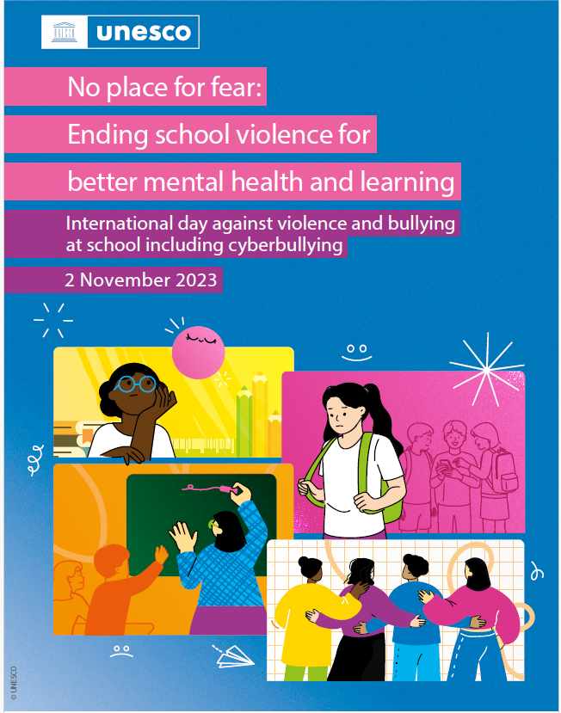
⚠️ Aucune forme de violence n'a sa place à l'école ! ⚠️
À l'occasion de la Journée internationale contre la violence et le harcèlement à l'école, y compris le cyberharcèlement, nous souhaitons attirer l'attention sur les liens étroits et alarmants qui existent entre la violence à l'école et la santé mentale
#NonAuHarcèlement #FinÀLaViolence
International Symposium – Rabat 2023
Notes:
UNESCO’s role is also to raise awareness and contribute to the mobilization of governments and all stakeholders to end all forms of school violence, including bullying and cyberbullying.​
​
In 2019, UNESCO’s Member States declared the first Thursday of November of every year, the International Day against Violence and Bullying at School Including Cyberbullying. ​
Each year, a theme is highlighted: This year's theme: No place for fear: ending school violence for better mental health and learning brings to light the critical connection between school violence and the mental well-being of learners, teachers, and other school personnel. For example, UNESCO’s flagship report, Behind the Numbers, shows that bullying and violence within educational settings can have profound and long-lasting effects on learners’ mental health, leading to feelings of loneliness and suicidal thoughts. ​
School violence – including bullying, cyberbullying and gender-based violence – has severe and long-lasting consequences on the mental health, well-being and education of children and adolescents.
Experiences at school such as violence amongst peers and bullying have been associated with anxiety, depression, suicidal thoughts and actions, and self-harm. Perpetrating violence is also associated with poor mental health, with evidence that children with emotional and behavioural disorders can engage in aggressive behaviours.
Violence affects children’s ability to learn. Learners facing or witnessing school violence are more likely to miss school, have lower grades and even drop out of school. Children who are bullied are twice as likely to feel lonely, to be unable to sleep and to have contemplated suicide. Preventing and responding to school violence including bullying, both offline and online, and gender-based violence, can have a direct impact on the protection of learners, their mental health and in turn, their learning. Teachers may also experience or witness violence, and many report stress and fear at working in a violent environment.
Once more, it is crucial to reiterate that everyone at school and within the broader education system has a role to play, from school personnel to the community, from parents and carers to policymakers and decision-makers. Beyond the education space, fostering safe and supporting learning environments requires engaging with other sectors such as health and child protection, recognizing the multiple factors that contribute to learners’ safety, mental health and well-being.

Slide 16
Joanna Herat, Chief (ai.) Section of Health and Education, Education Sector, UNESCO, Paris
For more information on UNESCO's work in the field of education for health & well-being : https://www.unesco.org/en/health-education

