Slide 1
Preventing violence in schools: an overview of the state of evidence on effective strategies
International Symposium: Violence in Schools:
Knowledge, Policies and Practices
Rabat, November 1-2, 2023
Dr Ramya Subrahmanian
UNICEF Innocenti - Global Office of Research and Foresight

Slide 2
What are we measuring globally?
Peer Violence
1. Bullying - aggressive behaviour that involves unwanted, negative actions, is repeated over time, and an imbalance of power or strength between the perpetrator or perpetrators and the victim.
Types: psychological, sexual, physical and cyber bullying
2. Physical fights (between peers)
3. Physical attacks (one or more aggressors against a student)
Harsh discipline and corporal punishment, and attacks on teachers rely more on country level data.
Main data sources: Global School-based Student Health Survey (GSHS) World Health Organization (WHO)
Notes:
There is no standard definition of bullying or cyberbullying in international surveys, with only three surveys – the GSHS, HBSC and PISA – providing explicit definitions.
Source:
1. Global School-based Student Health Survey (GSHS) World Health Organization (WHO) Since 2003; survey conducted every 3-5 years (for most countries) 13-17 year olds since 2013, and previously 13-15 year olds. 96 countries and territories across all regions except Europe and North America

Slide 3
Violence in schools, key facts
130 million children aged 13 to 15 bullied every year while in school (UNICEF 2018)
732 million children aged 6 to 17 live in countries where
corporal punishment at school is not fully prohibited (UNICEF 2018)
GLOBAL
12 million (close to half) children aged 13 to 15 bullied every year while in school (UNICEF 2018)
18 million children aged 6 to 17 live in countries where corporal punishment at school is not fully prohibited (UNICEF 2018)
MENA REGION
Notes:
That momentum and the demands of young people are both the context and inspiration for the next phase of the #ENDViolence campaign: Safe to Learn.
No child should be afraid to go to school. And yet, for far too many students around the world, school is a dangerous place.
These statistics give you a sense of the magnitude of the problem. They also illustrate how the school setting serves as a window into various types of violence: from bullying (both on and offline) to physical and sexual violence.

Slide 4
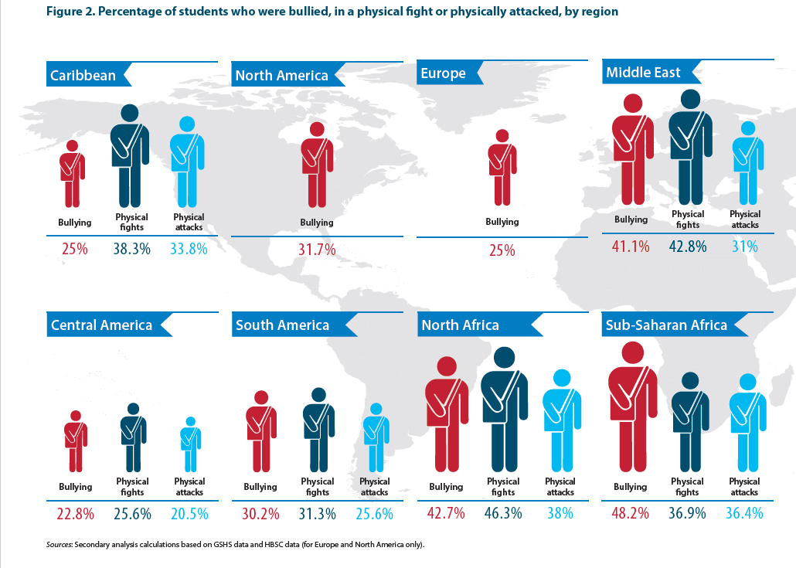
Notes:
Data for 2016 – reported in: UNESCO (2019) Behind the numbers: Ending school violence and bullying

Slide 5
Violence in schools, in Morocco (GSHS 2016)
38%
of children aged 13-15 years (44% boys and 32% girls) reported being bullied on one or more days during the 30 days before the survey
40%
of Moroccan children aged 13-15 reported having been in a physical fight one or more times during the 12 months before the survey (53% boys, 25% girls)
Trends in bullying have shown an increase in a 10-year period, 2006 - 2016
Trends in physical fights have remained the same
Trends in physical attacks have shown a decline
Notes:
That momentum and the demands of young people are both the context and inspiration for the next phase of the #ENDViolence campaign: Safe to Learn.
No child should be afraid to go to school. And yet, for far too many students around the world, school is a dangerous place.
These statistics give you a sense of the magnitude of the problem. They also illustrate how the school setting serves as a window into various types of violence: from bullying (both on and offline) to physical and sexual violence.

Slide 6
Factors underlying violent behaviours in school
Normalisation of violence as a means of control, self-expression, and self- or collective differentiation.
Behavioural drivers: stress, exposure to violence in the home
Social context within which school is embedded

Slide 7
Levels of action
National commitments
School Environment
Programme interventions
Notes:
Successful programmes: experimental or quasi-experimental designs with evidence of significant sustained effect on outcomes.
Promising programmes: experimental or quasi-experimental designs with evidence of effect on outcomes of interest; or non-experimental designs with evidence of effect on outcomes post intervention.
Emerging programmes with insufficient evidence: non- experimental design used; findings might suggest some positive results, but the design of the study is not sufficiently rigorous to determine effectiveness; only programmatic evidence.
Ineffective programmes: failed to demonstrate an effect.
We included 151 papers and reports in this review that documented 87 programmes in the Global South. The majority of the published studies were quasi-experimental and related to impact and outcomes evaluations. The grey literature used comprised a mixture of formative evaluations, process evaluations and reviews of programme data to assess programme successes and outcomes.
Here I would include the percentage distribution, majority can mean many things and it would be better to be precise here. Of the 87 programmes, x (x%) were impact evaluations using quasi-experimental methods.

Slide 8
State of the evidence on intervention effectiveness
Violence against children
Large body of evidence on effectiveness
Violence in schools
Moderate body of evidence on effectiveness
(Torres et al 2023; Lester et al. 2016)
Violence against children online
Limited body of evidence on effectiveness
Notes:
. Does our knowledge come from a handful of interventions or is the body of evidence more substantive? I added links to select systematic reviews. For example, Lester et al. highlight that we know a great deal about what works to prevent peer aggression at school, but there is very little on the prevention of teacher-on student violence (including corporal punishment

Slide 9
Intersecting and overlapping programme strategies
Developing knowledge and life skills
Building safe environments
Addressing harmful gender norms and values
Providing psychosocial support (response and support services)
A Whole School approach

Slide 10
Developing knowledge and life skills
Building knowledge to reduce risk of violence
Examples from: South Africa, Indonesia, Taiwan and South Korea
Building self-protection skills: Ecuador, Thailand & Malaysia,
Building the capacity to manage conflict and aggression
Examples from Uganda, Thailand and Nigeria show promise in the use of group
Behavioural and social skills development –Examples from Turkey, Colombia and Brazil
Empowerment and building resilience:
Examples from El Salvador, Zambia, South Africa, Nigeria, Tanzania, Uganda
Notes:
Building knowledge to reduce risk of violence, including the use of activities such as games, a comic and web-based learning to increase the conceptual understanding violence to enable better protection. Examples from: South Africa, Indonesia, Taiwan and South Korea.
Building self-protection skills: skills-based training using psycho-education to build the safety and self-protection skills of learners. Ecuador, Thailand & Malaysia, promising for developing capacity of teachers, and increasing knowledge and self-esteem but efficacy for self-protection not proven
Building the capacity to manage conflict and aggression by building self-awareness and the cognitive and problem-solving skills of learners. Examples from Uganda, Thailand and Nigeria show promise in the use of group based cognitive behavour techniques, using curriculum-based techniques focused on conflict management, impulse control, anger management, kindness, forgiveness, empathy and reconciliation.
Behavioural and social skills development – to promote greater emotional competence, including conflict resolution, emotional self-control and adaptive coping strategies, with examples from Turkey, Colombia and Brazil
Empowerment and building resilience: using school clubs and peer support groups, with a focus on building self-esteem. Examples of diverse programmes in El Salvador, Zambia, South Africa, Nigeria, Tanzania, Uganda

Slide 11
Example: After-school programmes for at-risk adolescents in Latin America
Venezela, Urugay, Peru: Participation in after- school programs based on sport and music had a significant effect on improving children’s behaviour
Colombia: A multi-component programme, Aulas en Paz (Classrooms in Peace), was implemented to prevent aggression and promote peaceful relationships, with components engaging both teachers and parents.
The universally targeted components focused on building citizen competencies and were integrated into the school curriculum. It was also found to be cost-effective.

Slide 12
Mechanisms of impact
(1) team building;
(2) self-regulation and self-monitoring;
(3) stress-release;
(4) personal mentoring;
(5) increasing time with adult supervision;
(6) increasing human capital;
(7) introducing positive aspirations; and
(8) including the family in the program.

Slide 13
Addressing harmful gender norms and promoting equitable relationships
Promoting gender equality in diverse school settings, with diverse methods
Engaging teachers, youth, boys and girls across ages in age-appropriate ways
Examples in India, Mexico, Pakistan, Kenya have shown very positive results in reduction of peer violence, promotion of bystander intervention and positive attitudes related to gender.
Other strategies include reducing dating violence and intimate partner violence, and improving adolescent sexual and reproductive health

Slide 14
Online violence
An emerging area of research. However, important to note that the ‘digital world’ intersects with ‘offline’ contexts of schools and teaching practices.
Gender dimensions are critical – boys more likely to be perpetrators, or perpetrator-victims.
Channels of victimization also vary – some studies suggest that girls experience cyber-bullying through social media whilst boys experience it through video games and text messages.
Cyber-bullying perpetration and victimization have common predictors.
These include having weaker offline social ties and support from friends and family, loneliness, lower social likeability at school, lower psychological well-being, and having an impulsive personality.
Conversely, protective factors in relation to cyber-bullying include:
A positive relationship with parents, parental monitoring of children’s activities (generally rather than online only), teacher care, enforced school rules, higher self-efficacy, self-confidence and resilience.

Slide 15
Lessons learned from programme interventions
Moving from programmes to scaled up systems needs investment in:
Multi-component approaches
Strengthening the school environment
Using group-based programmes
Ensuring sensitivity to age-appropriate and gender-responsive strategies
School Staff, who are central to success
Adaptation to context
Systems ownership

Slide 16
Schools as key institutions for addressing violence
Schools are positive spaces for children
Schools provide social context and infrastructure
Schools can implement carefully targeted interventions for a sustained period of time.
Schools can positively influence the developmental trajectories of children
Notes:
Schools can be positive spaces for children who are exposed to a range of forms of violence or risks of harm within homes and communities
Schools provide a social context that comes along with established infrastructure and resources that could support violence prevention initiatives – e.g. identifying high risk learners and targeting appropriate resources to them.
Schools are attended by children and youth who are at critical developmental stages in their lives. Carefully targeted interventions can positively influence their developmental trajectories
Schools have a captive audience and can implement carefully targeted interventions for a sustained period of time. This will ensure that poly-victims who are attending schools, can access continued support services during the years that they’ll be attending school.

Slide 17
A “Whole School” approach
Focus on the whole school environment, including all stakeholders
Examples from Uganda, but also Chile, India
Variations in intensity, duration of components across these examples
Delivery in school, within school hours
Focus on policies, procedures and processes

Slide 18
National laws and policies
Around 720 million school-age children live in countries where they are not fully protected by law from corporal punishment at school.
However, there are several countries which have directly legislated against violence in schools, or specific forms of violence such as bullying, or indirectly included violence in broader laws against violence. These countries include Korea, Australia, Finland, Japan, Norway, South Africa, Norway, Mexico, Peru, Philippines
While laws are insufficient by themselves, they are necessary to signal clear commitment and can contribute to shifting societal norms.

Slide 19
Lessons for research
Greater investment in high-quality research needed – evaluation, operational and implementation studies.
Bridge north-south gap in investment.
Focus on sustainability of results – longer-term follow up
Invest more in mapping and understanding mechanisms of change

Slide 20
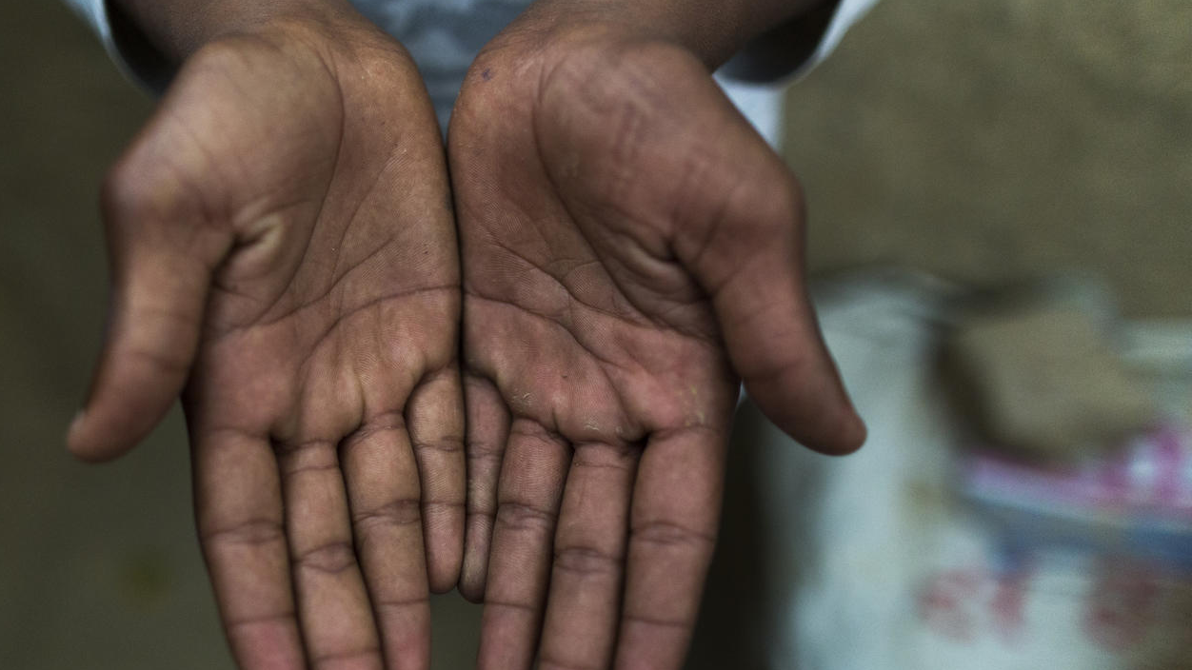
THANK YOU
rsubrahmanian@unicef.org

Slide 21
References
Cid, A. 2017. “Interventions using Regular Activities to Engage High-risk School-age Youth: A Review of After-school Programmes in Latin America and the Caribbean.” Background paper. Ending Violence in Childhood Global Report 2017. Know Violence in Childhood. New Delhi, India
Stoilova, M., Livingstone, S., and Khazbak, R. (2021) Investigating Risks and Opportunities for Children in a Digital World: A rapid review of the evidence on children’s internet use and outcomes. Innocenti Discussion Paper 2020-03. UNICEF Office of Research – Innocenti, Florence
Behind the Numbers: Ending School Violence and Bullying 2019 UNESCO. Behind-the-Numbers.pdf (unicef.org)
School Violence and Bullying. Global Status Report 2017. UNESCO
Lezanne Leoschut & Zuhayr Kafaar (2017): The frequency and predictors of poly-victimisation of South African children and the role of schools in its prevention, Psychology, Health & Medicine, DOI: 10.1080/13548506.2016.1273533 To link to this article: http://dx.doi.org/10.1080/13548506.2016.1273533
Mathews S, Achyut P, October L & Makola L. (2021). Evidence Review: Prevention of violence against children through schools in the Global South. Raising Voices, Uganda and University of Cape Town, South Africa.
Wex, B., M. Bulger and P. Burton. 2017. “Online Violence in Schools: Beyond Cyberbullying.” Background paper. Ending Violence in Childhood Global Report 2017. Know Violence in Childhood. New Delhi, India.
Know Violence in Childhood. 2017. Ending Violence in Childhood. Global Report 2017. Know Violence in Childhood. New Delhi, India

