Slide 1

SOCIAL SERVICE WORKERS
IN SCHOOLS
Their role in addressing violence against children and other child protection concerns
Key findings and recommendations of our technical note
Hugh Salmon
Director,
Global Social Service Workforce Alliance

Slide 2
Why was Daniel Invisible?
Daniel died in a large English city, aged 4, in 2012 after suffering prolonged abuse and neglect by his parents.
A serious case review found Daniel was "invisible" at times and "no professional tried sufficiently hard enough" to talk to him.
He was starved and beaten for months before he died. Daniel saw a doctor in hospital for a broken arm, arrived at school with bruises and facial injuries, and was seen scavenging for food. A teaching assistant described him as a "bag of bones“. At his parents’ trial heard experts said for several months he had been "wasting away". At the time of his death the schoolboy weighed just over 10kg.
Police were called to 26 separate incidents at the family home, many involving domestic violence and alcohol abuse.
The report found that professionals needed to "think the unthinkable" and act upon what they saw, rather than accept "parental versions“.
Daniel's "voice was not heard" because English was not his first language and he lacked confidence. No record was made of "any conversation" held with Daniel about his home life, his experiences outside school, or of his relationships with his siblings, mother and her partners.

Slide 3
Why was Daniel Invisible?
There were "committed attempts" by his school and health workers to address his "health and behavioural issues" in the months before his death, but the teachers. But "too many opportunities were missed for more urgent and purposeful interventions“
Twice he was admitted to hospital but the explanation of the parents for the injuries was accepted as "plausible“, rather than being fully explored. Excuses made by Daniel's "controlling" mother were accepted by agencies.
The review said Daniel could have been offered greater protection if the professionals involved had applied a "much more enquiring mind". It also identified school staff did not link Daniel's physical injuries with their concerns about his apparent obsession with food, which his mother claimed was caused by a medical condition.
Daniel's head teacher said: "His mother was a convincing manipulator.
Ms Weir said the idea of Daniel being "invisible" was "at the heart of this case".

Slide 4

WhAT is the Social Service Workforce?
GLOBAL SOCIAL SERVICE WORKFORCE ALLIANCE definition
The social service workforce is an inclusive concept referring to a broad range of
governmental and nongovernmental
professionals and paraprofessionals
who work with children, youth, adults, older persons, families and communities
to ensure healthy development and well-being.
The range of titles and roles :
social workers,
social educators,
social pedagogues,
child and youth care workers,
community development workers
community liaison officers
community workers,
social welfare officers,
social/cultural animators,
case managers
para / auxiliary social workers
They provide
preventive, responsive and promotive services,
and operate at
macro, mezzo and micro levels.
Global Social Service Workforce Alliance.
2019. SSW Definition.
Notes:
As you can see from the umbrella and the different colours of workers in the image, here we are trying to illustrate that the social service workforce includes a broad range of professionals and paraprofessionals (so those who have formal university qualifications and those who may undergone special on the job training), government and NGO workers.
They also work with a wide range of people, from children and youth to older people, adults with particular needs, whole families and communities.
The definition on the left was developed through a long and wide process of consultation with stakeholders across the globe. On the right some of the different titles used in different contexts are mentioned. (change to list?).
Not only do they have a wide range of roles and titles, their functions and responsibilities range from providing preventing and responsive services, at the micro and mezzo levels (i.e. working with individuals and communities), to promoting the workforce through advocacy, training, monitoring and supervision, at all levels including the macro, national level.

Slide 5
A Wide RANGE of Personnel May hAVE Roles In Violence Prevention & Child Protection in Schools
School director or deputy director has role of child protection focal point, for reporting purposes
Member of school leadership team with responsibility for overall student welfare
School counsellor – mostly teachers trained in counselling to address school-centred issues
Professional counsellor or psychologist placed in school or linked to a school
Education welfare officer employed by school / education dept
Social pedagogue employed by school / education dept
Attendance officer appointed as member of school staff
School social worker / education social worker, often placed in school by social services dept
Child protection social worker linked to a school or cluster of schools
But the ideal is for these roles to complement (not substitute for) a:
Whole school approach – all students and parents, staff and administrators share goals, values and develop practices to ensure safe and child friendly schools in the context of safe and child friendly communities

Slide 6
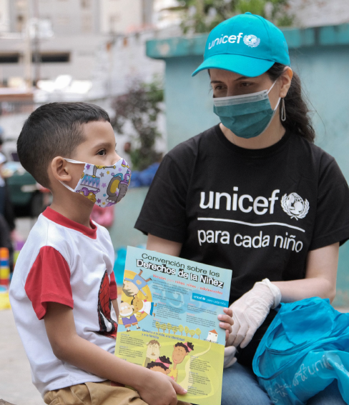

1. Schools are critical spaces to address violence against children and other child protection concerns
Schools provide opportunity and space to address a wide set of child protection challenges.
Children spend a lot of time each day in school, so it’s where child protection concerns can often be identified and addressed.
School-based child protection concerns do not occur in isolation from their societal context.
A ‘whole school approach’ to child protection, prevents violence and enhances students’ overall well-being engagement in school.
For the most marginalized students, schools can provide crucial support services that they would otherwise struggle to access.
© UNICEF/UN0384244/CAÑAS

Slide 7
2. States are obligated to protect children from all forms of violence in school settings
Schools have a responsibility to respond to child protection needs.
International legal norms and standards clearly articulate the indivisibility of children’s rights in education and child protection.
A child’s right to protection applies in all settings, including schools.
© UNICEF/UN0222337/BROWN

Slide 8
3. Preventing and addressing child protection in schools also helps achieve educational outcomes
Child protection in schools helps countries meet the education goals in the SDGs
Child protection in schools reduces barriers to learning, and meeting students’ basic physical and psychosocial needs, leading to better learning outcomes & overall well-being.
© UNICEF/UNI330895// FRANK DEJONGH

Slide 9
4. Children are better protected in schools – wHose Child PROTECTION policies ARe integrated with wider CHILD PROTECTION systems
.
Ministries of education should budget and plan for child protection, and child participation, in education strategies.
Collaborative, team-based approaches with shared goals among teachers, school administrators, social service workers and community members are critical to achieve safe and positive learning environments, and for effective coordination of services and interventions.
© UNICEF/UN0520217/ARCOS

Slide 10
5. trained and supported SCHOOL STAFF can address CP issues, but THEY HAVE limited time and capacity to DO SO.
In many countries, teachers and school administrators lack the skills, time, support and mandate to recognize signs and symptoms of abuse or violence, to record concerns, to make referrals or work with external agencies.
SSW in schools can address CP issues as they arise and connect interventions at school with the wider child protection system and services.
Education authorities should also recruit, train, support and monitor teachers to ensure successful child protection responses.
© UNICEF/UN0464829/HIMU

Slide 11
6. The social service workforce should be integrated into schools and education systems
The key role of the social service workforce needs to be recognized by ministries of education.
Ministries of education need to work together with ministries of social welfare to ensure the integration of the workforce within education structures.
They need to be clear on the scope of services that SSW in schools can provide.
Realistic job descriptions, working conditions, capacity developments, support and supervision are essential for effective social service workforce practice in schools.
© UNICEF/UNI351545/BECI

Slide 12
6. INTEGRATION OF SOCIAL SERVIcE WORKERS into SCHOOLS (continued)
The focus of the SSW in schools will depend on professional training, age of students served, school district size and prevalent child protection concerns.
The efficiency and effectiveness of the SSW will depend on the availability and quality of wider child protection services and the quality of the referral system itself.
SSW can be school-based, or linked to one or a cluster of schools, with regular visits to each – which model is best, depends on context and resources.

Slide 13
7. Effective child protection in schools is underpinned by multi-stakeholder engagement and a holistic approach
Effective child protection in schools relies on multi-stakeholder engagement built on trusting relationships at all levels…..
and on holistic approaches with an ecological perspective which sees and engages with the student in the context of their family, school and community.
© UNICEF/UN0280984/VISHWANATHAN

Slide 14
8. FOR Social Service Workers TO engage with families, communities & OTHER AGENCIES, THEY NEED robust referral & outreach mechanisms
It is essential for schools and the services within wider child protection systems to understand and cooperate with each other, to foster safe and successful learning environments.
Social service workers can play a critical job facilitating effective coordination of services and interventions, including referrals and follow-up.
Schools should engage families and communities as meaningful partners.
© UNICEF/UN0579231/HTET

Slide 15
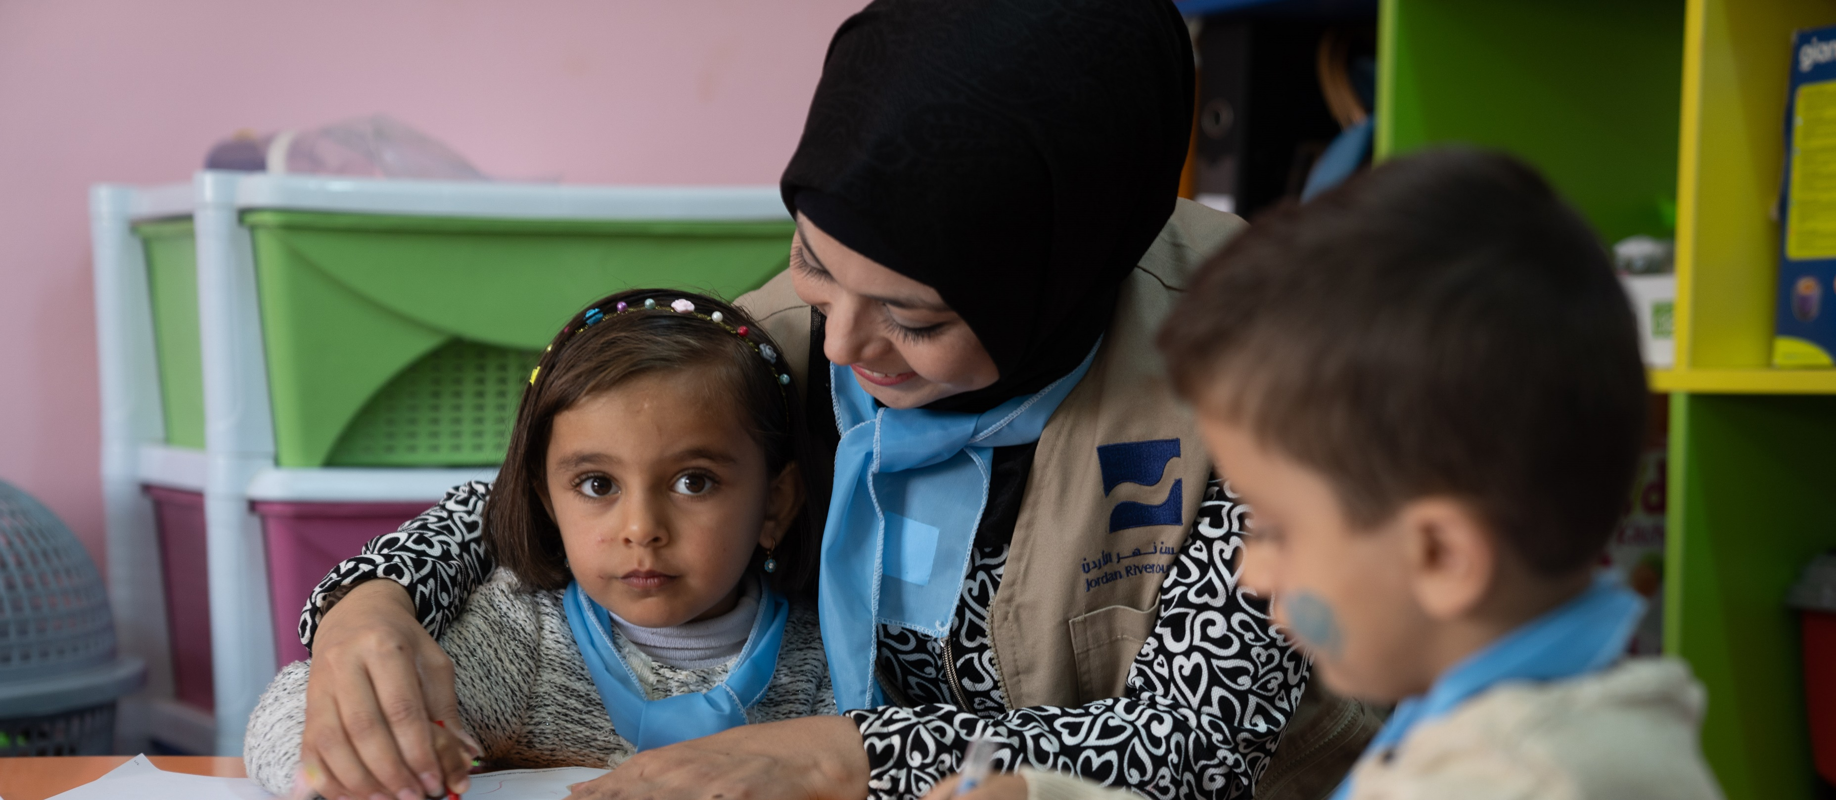
9. WE NEED TO advocate for the effective development and professionalization of the SSW in schools
Most countries lack programmes involving SSW in schools.
There is a need to advocate for the social service workforce to be built into the planning and resourcing of schools – including through training, and defining the standards and mandates for their work in schools, supported by professional associations.
Capacity building for teachers, school administrators and social service workers should cover all their roles in child protection including identification, referrals, coordination, monitoring and response.
.

Slide 16


Pros and cons of placing SSW in schools v linking with school(s)
Type of inter-sectoral arrangement | Advantages | Disadvantages
1. Linking: SSW employed and supervised by social services department but linked with a specific school or cluster of schools | The benefits of inter-sectoral and multi-disciplinary working, but at lower cost to school - the education dept or school doesn’t fund or manage the SW, but must provide meeting space | May not improve joint working and coordination enough to achieve enhanced outcomes for services users – if trust, mutual recognition still lacking
2a. SSW employed and supervised by social services, but placed in the school. | Achieves the benefits of joint work of cross-sectoral colleagues being co-located, but without requiring education dept / school funding | The lower level of ownership by management of the school / education dept may result in lower commitment to effective cooperation
2b. SSW recruited, paid, managed & supervised by the service where they are located. | Strong ownership by the school & education sector. Clear management and reporting lines. | The school director may not be able to meet SSW need for supervision & professional development
2c. SSW recruited, paid and managed & supervised by the service where they are located, but supervised by SW in social services dept. | Same as 2b., but added advantage of receiving supervision from an experienced social worker, to strengthen their SW practice in school | SSW could receive conflicting advice from service manager, and colleagues on-site, and from their off-site supervisor
© UNICEF/UN0222337/BROWN

Slide 17
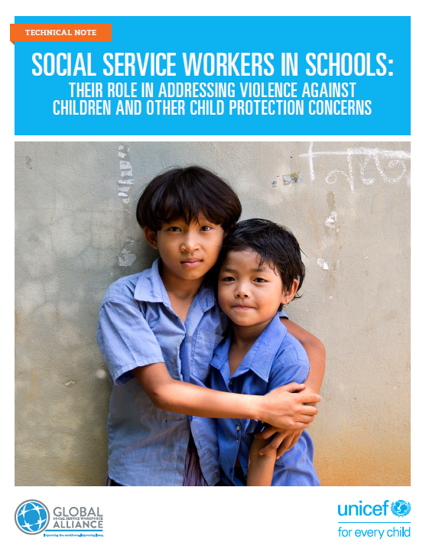
Download the technical note: www.socialserviceworkforce.org

